Slide 1
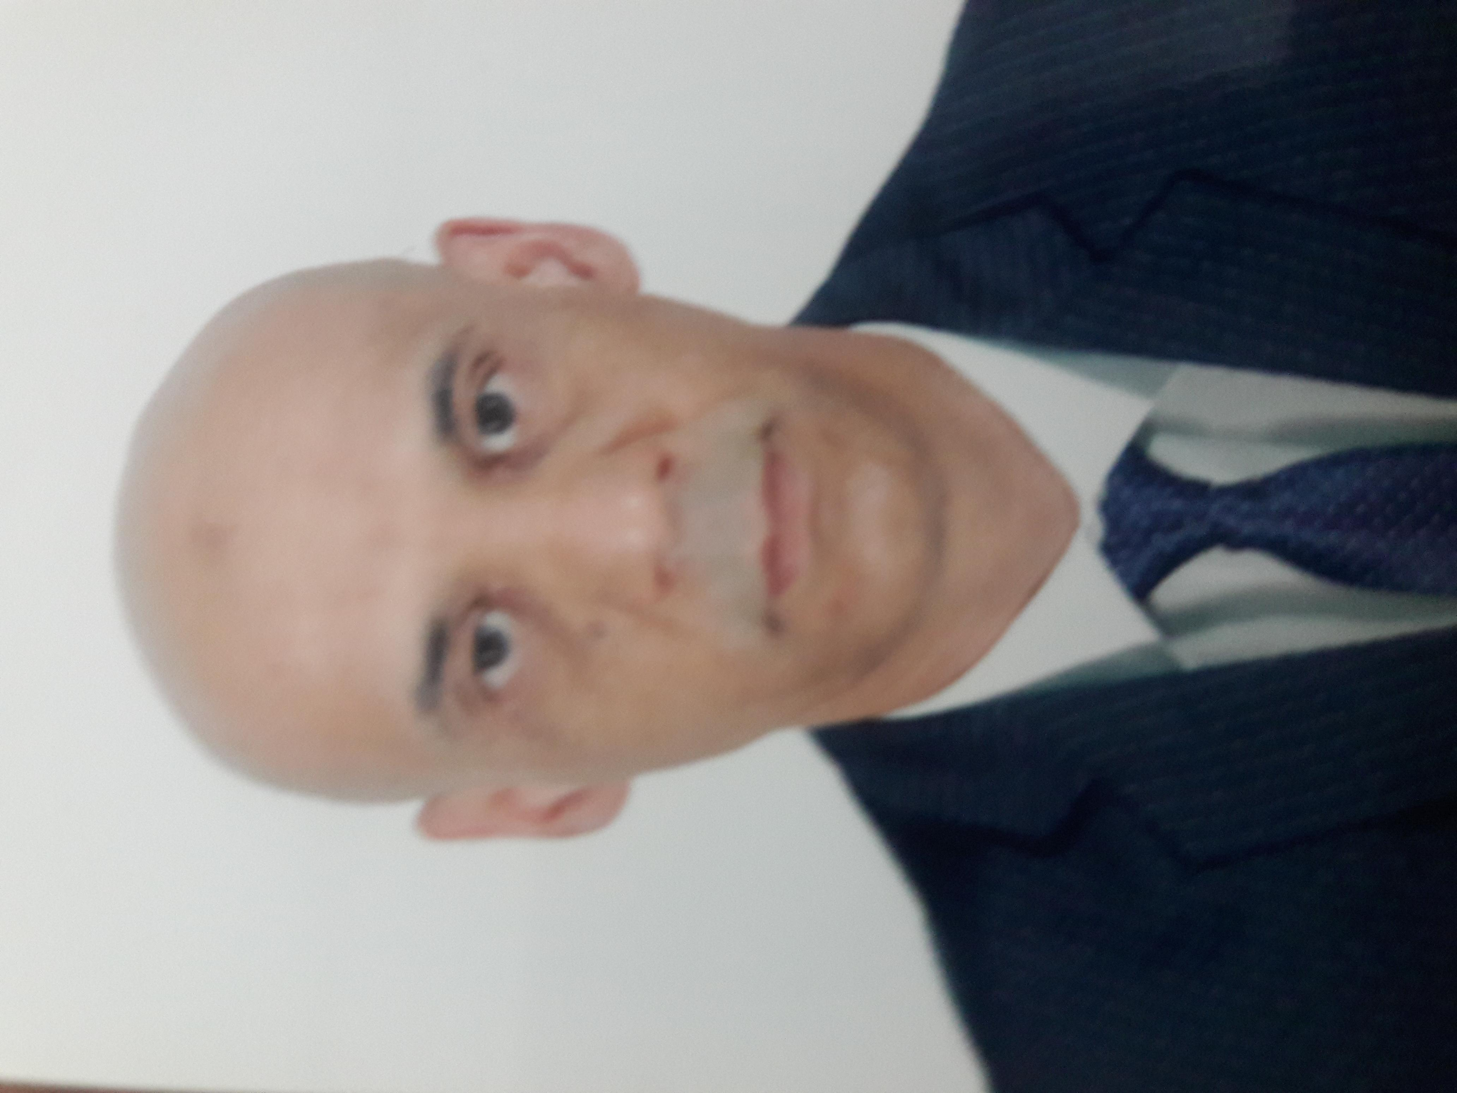

Founding Partners’ Profiles
PROFILE
EXPERIENCE
XXXXXXXXXXXS
YYYYYYYYYYYYY
Partner and co-founder at Global Marble …..
- Market Research: (Quant, Qual, Panels), Data Analysis,
- Brands Performance, Consumer insights.
BAHANI BILLEL
CEO Sal Mdjareb
UNIVERSITE DE BLIDA; INSIM
10 years in Market research and project management
Founding partner at xyz
Director at the Nielsen Company overseeing retail measurement Services across North Africa
Director at Global Health TV – covering global health issues in Africa- WebsEdge TV- UK
Partner and co-founder at IMS Research
- Market Research: (Quant, Qual, Panels), Data Analysis,
- Brands Performance, Consumer insights.
CEO SmartRocket Africa (Intelligence retail Audit)
BOUBAKER HAMMOU
C00 Sal Mdjareb
UDM; Montreal, Canada
20 years in Market research and project management
CEO SmartRocket Africa & Founding partner IMS Research

